Slide 1

HOPE
-NGO Finder
Spread hope, Spread happiness
Team Members:-
Khushi Shaw
Neeyati Checker
Paridhi Pasrija
Utkarsh Singh

Slide 2






Sustainable Development Goal 16
Peace
Justice
Strong Institution

Slide 3
Problem Statement
We have to manually search for the type of NGOs’ we want to work for
No guarantee if the NGO is genuinely working for the specific social cause
Difficulty in finding the contact information sometimes
Many a times authentication is required which can take a lot of time
Sometimes people get scammed when they visit a random NGO for donations

Slide 4
Solution -NGO Finder
Convenient
Trustable and authenticated NGO’s connected with our app
Easy to search for the type of NGO a person wishes to work for
Everything sorted and ready for the users
User-friendly
Our app reduces the risk of money fraud by verifying the NGO’s before registering

Slide 5
AIM
Our app's main aim is convenience as this is something which would take a lot of time to search on the internet. We are providing a combined and convenient solution like finding an NGO according to your locality, choosing an issue that you want to know more about or spread awareness on thereby making it easier for the user to help the society at his/her level.

Slide 6
Read Before Instructions:-
This is just a prototype and not a fully developed app
The NGO’s listed are real
They may or may not be genuine and trustworthy
Only the underprivileged children category is working
The rest of the categories are for display
The login page is still in the development process
Navigate to the home page by using any email ID and password

Slide 7
How are app works?
On opening the app you will be able to see the front page, our logo and the tag line.
At the bottom there will be a 'register now' button that will lead you to the home page.
Select the location You will see three locations, i.e., Gurgaon, Delhi and Faridabad which you can select according to your locality.
Once you select your locality it will lead you to the category page where you can see all the different NGO's that city is working on (check the underprivileged children category).
Once you will choose your preferred category you will see all the NGO's working on that particular issue in your chosen location.

Slide 8
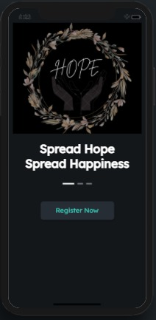

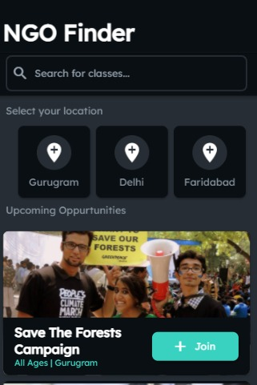
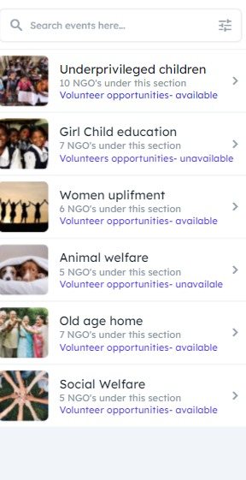
Front Page
Login Page
Home Page
Category Page
Click on Register Now
Sign in or Sign Up
Search manually
Or
Select your location
Select the desired category

Slide 9
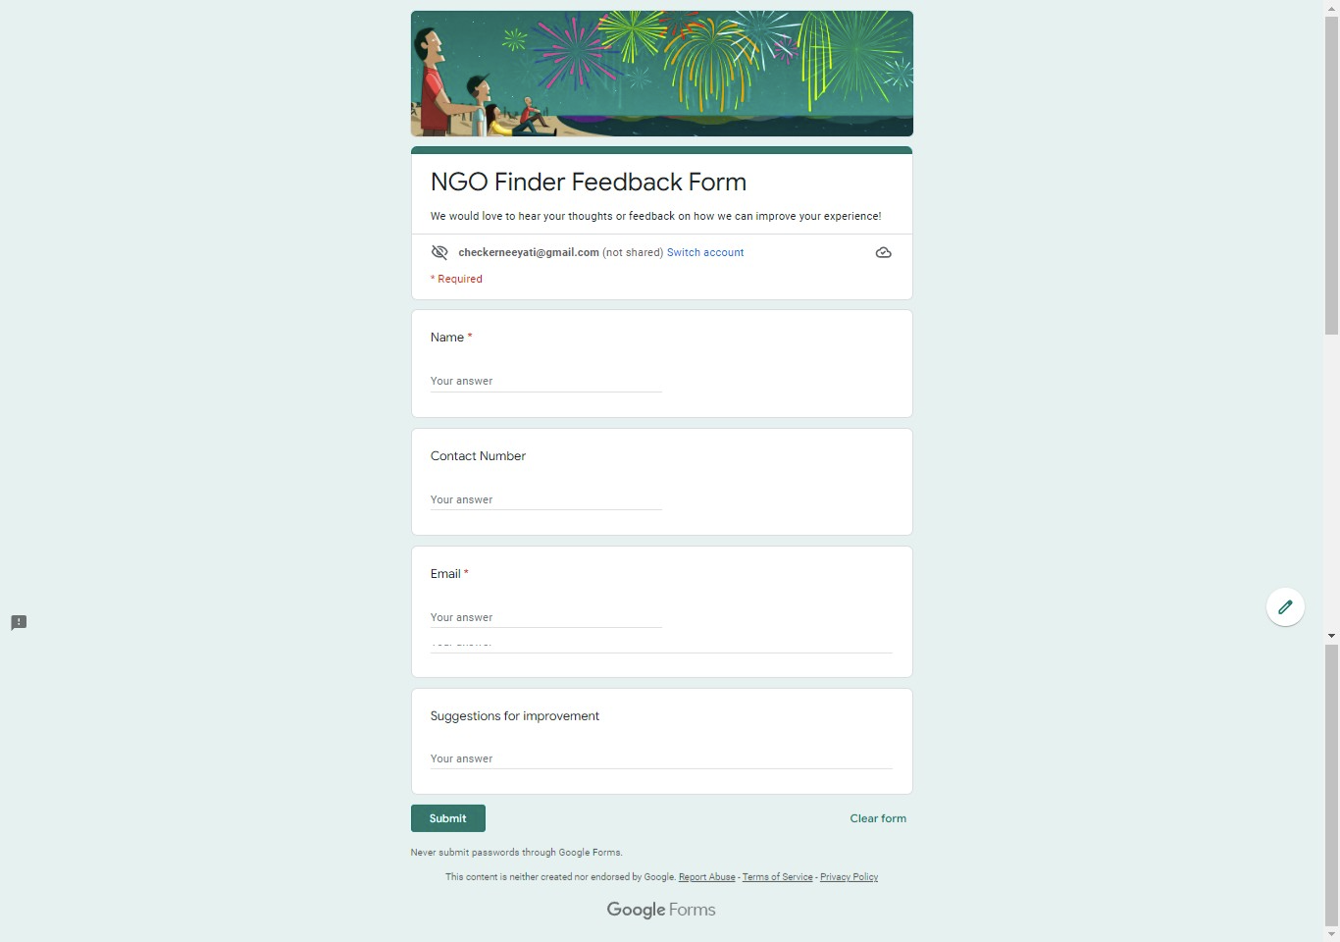
Feedback Form

Slide 10
Future Goals: HOPE 2.0
More areas covered
More NGO’s added after proper verification
Delivery services for those who want to donate but travel is not possible.

